Slide 1
Probability of Causation of lung cancer
Javier Mancilla Galindo
PhD Candidate
Acknowledgement supervisors: Dick Heederik, Susan Peters, Lützen Portengen

Slide 2



What caused this worker’s lung cancer?
Genetics
Asbestos
Lifetime smoker
1.8 fiber-years
RCS
1.9 mg/m³-years

Slide 3
Is this worker entitled to financial compensation?
Asbestos
Lifetime smoker
1.8 fiber-years
RCS
1.9 mg/m³-years

Slide 4
If so, who should compensate them?
Worker
Asbestos
Tobacco industry
Employer 1
Lifetime smoker
1.8 fiber-years
Employer 2
RCS
Government?
1.9 mg/m³-years
Employer 3
No one (genetics, nature…)

Slide 5
The board of experts calculates the Probability of Causation (PoC) of lung cancer for this worker applying for compensation…
Asbestos
Lifetime smoker
1.8 fiber-years
PoC = 0.25
PoC = 0.55
RCS
1.9 mg/m³-years
PoC = 0.30

Slide 6
Structure of this talk
Compensation schemes for occupational diseases: legal background
Causality criterion: Probability of Causation (PoC)
Exposure-response estimation and PoC
Lung cancer due to asbestos: ECHA and SYNERGY
Discussion
Final thoughts on our worker with lung cancer

Slide 7
OCCUPATIONAL DISEASE COMPENSATION (LEGAL)
TORT LAW
VS
COMPENSATION SCHEMES (TSB)
CORRECTIVE
JUSTICE
SOCIAL, DISTRIBUTIVE
YES, PART WHO CAUSED THE DAMAGE
LEGAL OBLIGATION
NO, THIRD-PARTY
YES
(SCHADEVERGOEDING)
FULL COMPENSATION
NO (TEGEMOETKOMING)
FAULT
SYSTEM
NO-FAULT, EX-GRATIA
MORE LIKELY THAN NOT P > 0.5
CAUSALITY CRITERION
NONE OR RELAXED
Overheul AM. Compensatieregelingen voor beroepsziekten. Doctoral thesis. Universiteit Utrecht; 2025. doi:10.33540/2765

Slide 8

Government-established compensation scheme for occupational diseases
Reduce administrative and psychological burden for the affected. Secondarily, reduce burden to legal system.
Provide “fast” (provisional) financial support.
Avoid lengthy and complicated litigations.
TSB: Compensation for pain and suffering, and social recognition for injured parties.

Slide 9
What is the PoC?
Early uses and definitions:
Because workers' compensation laws require only reasonable probability (more than 50% likelihood) that dermatitis is work-related, the answer to at least four of these seven criteria should be "yes" before the clinician concludes that dermatitis is probably occupational.
Toby Mathias CG. JAAD. 1989;20(5, Part 1):842-848. doi:10.1016/S0190-9622(89)70096-7

Slide 10
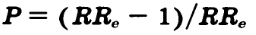
What is the PoC?
Early uses and definitions:
…the chance that a given case of cancer in a person exposed was caused by the exposure in question.
…excess incidence ( R_{e} - R_{u} ) due to exposure, divided by the total incidence in exposed (R_{e})
Armstrong B, Tremblay C, Theriault G. JOEM. 1988;30(10):771-775. doi:10.1097/00043764-198810000-00004

Slide 11
Formal definition: Judea Pearl and Tian
Probability of Causation
P Sufficiency
P Necessity
Can asbestos cause lung cancer?
What would happen if a healthy individual is exposed to asbestos?
Did asbestos cause lung cancer?
Would lung cancer not have occurred in the absence of exposure to asbestos?
Tian J, Pearl J. Annals of Mathematics and Artificial Intelligence. 2000;28:287-313. doi:10.1023/A:1018912507879

Slide 12
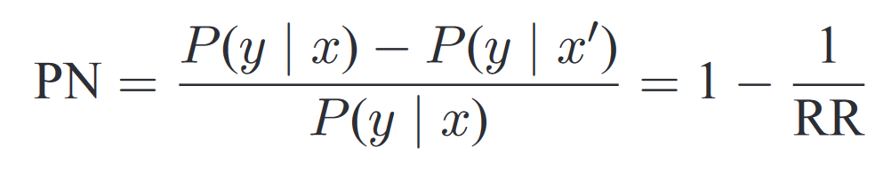
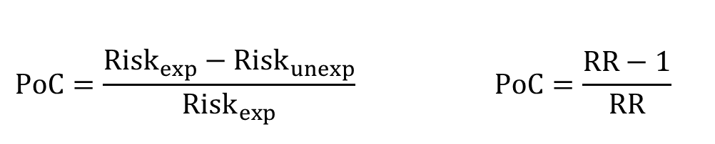
Formal definition: Judea Pearl and Tian
Unidentifiable, unless causal assumptions are made:
Causal model
Exogeneity: No confounding
Monotonicity: exposure cannot be protective
$$PoC=\frac{Risk_{exp}−Risk_{unexp}}{Risk_{exp}} PoC=\frac{RR−1}{RR}$$
Tian J, Pearl J. Annals of Mathematics and Artificial Intelligence. 2000;28:287-313. doi:10.1023/A:1018912507879

Slide 13
Objective
Determine occupational exposure thresholds where lung cancer is more likely than not caused by asbestos for workers’ compensation.
Presumably plausible principle (uncertainties in favor of claimant)
Two approaches for exposure-response estimation:
ECHA study: Occupational standard setting in Europe
SYNERGY study: Reflects contemporaneous exposure, high quality

Slide 14
ECHA
SYNERGY
Systematic review and meta-regression of 22 studies
130,341 participants
Pooled case-control study from 14 studies across Europe and Canada
Individual participant data
17,705 cases, 21,813 controls
Study Design
Mostly occupational cohorts reporting SMR (17 studies)
Only 2 studies with smoking-adjusted relative risks
Controls: 79% general population, 21% hospitals
Cumulative incidence (11 studies) and density sampling (3 studies) with frequency matching (age, sex). Adjusted smoking.
Study population and risk estimates
Exposure/recruitment: 1890–2009
(16 studies pre-WWII)
Recruitment: 1985–2010
Exposure: 1922–2009
Period
High quality: 7 studies
Low quality: 15 studies
(Poor documentation, low contrast, external fibre conversion factors, incomplete job history)
Quantitative job exposure matrix (SYN-JEM):
Region, duration, period of exposure within ISCO-68 job titles, incorporates country-specific asbestos bans.
Exposure Assessment
Up to 4,710 fibre-years
Median: 89.1
IQR: 19.9–252.4
Up to 64.6 fibre-years
Median: 1.33
IQR: 0.55–3.22
Reported Exposure

Slide 15
Methods
ECHA: Random-effects meta-regression
Spline, fixed intercept
Study-level logRR and average exposure level per exposure category reported
SYNERGY: Meta-analysis of individual participant data
Mixed-effects logistic regression
Study-specific random intercepts and random slopes for exposure
Adjusted for age, sex, smoking (pack-years), and time since quitting smoking

Slide 16
Heterogeneity (I²)
Proportion of total variation attributable to genuine differences between true effects rather than sampling error
“Non-overlap between confidence intervals”.
Prediction intervals (95% PI)
Range in which the true effect estimate from a new study would be expected to fall, accounting for both sampling uncertainty and between-study heterogeneity.
“effect size for any one subject (randomly sampled from the population)”
Borenstein M, Higgins JPT, et al. Research Synthesis Methods. 2017;8(1):5-18. doi:10.1002/jrsm.12305

Slide 17
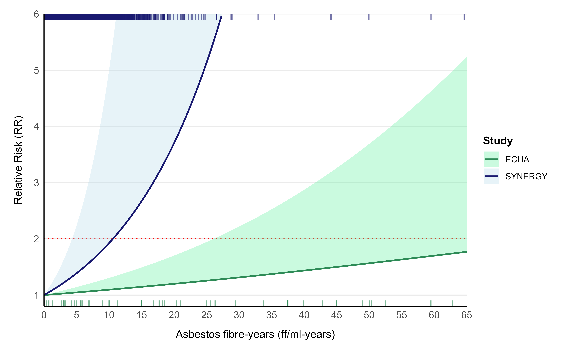
 | I² | Risk increase per fibre-year (95% PI)
ECHA | 92.7% | 1.1% | 0% - 3.6%
SYNERGY | 63.4% | 6.8% | 0% - 17.7%
Helsinki (2014) | - | 4% | -

Slide 18
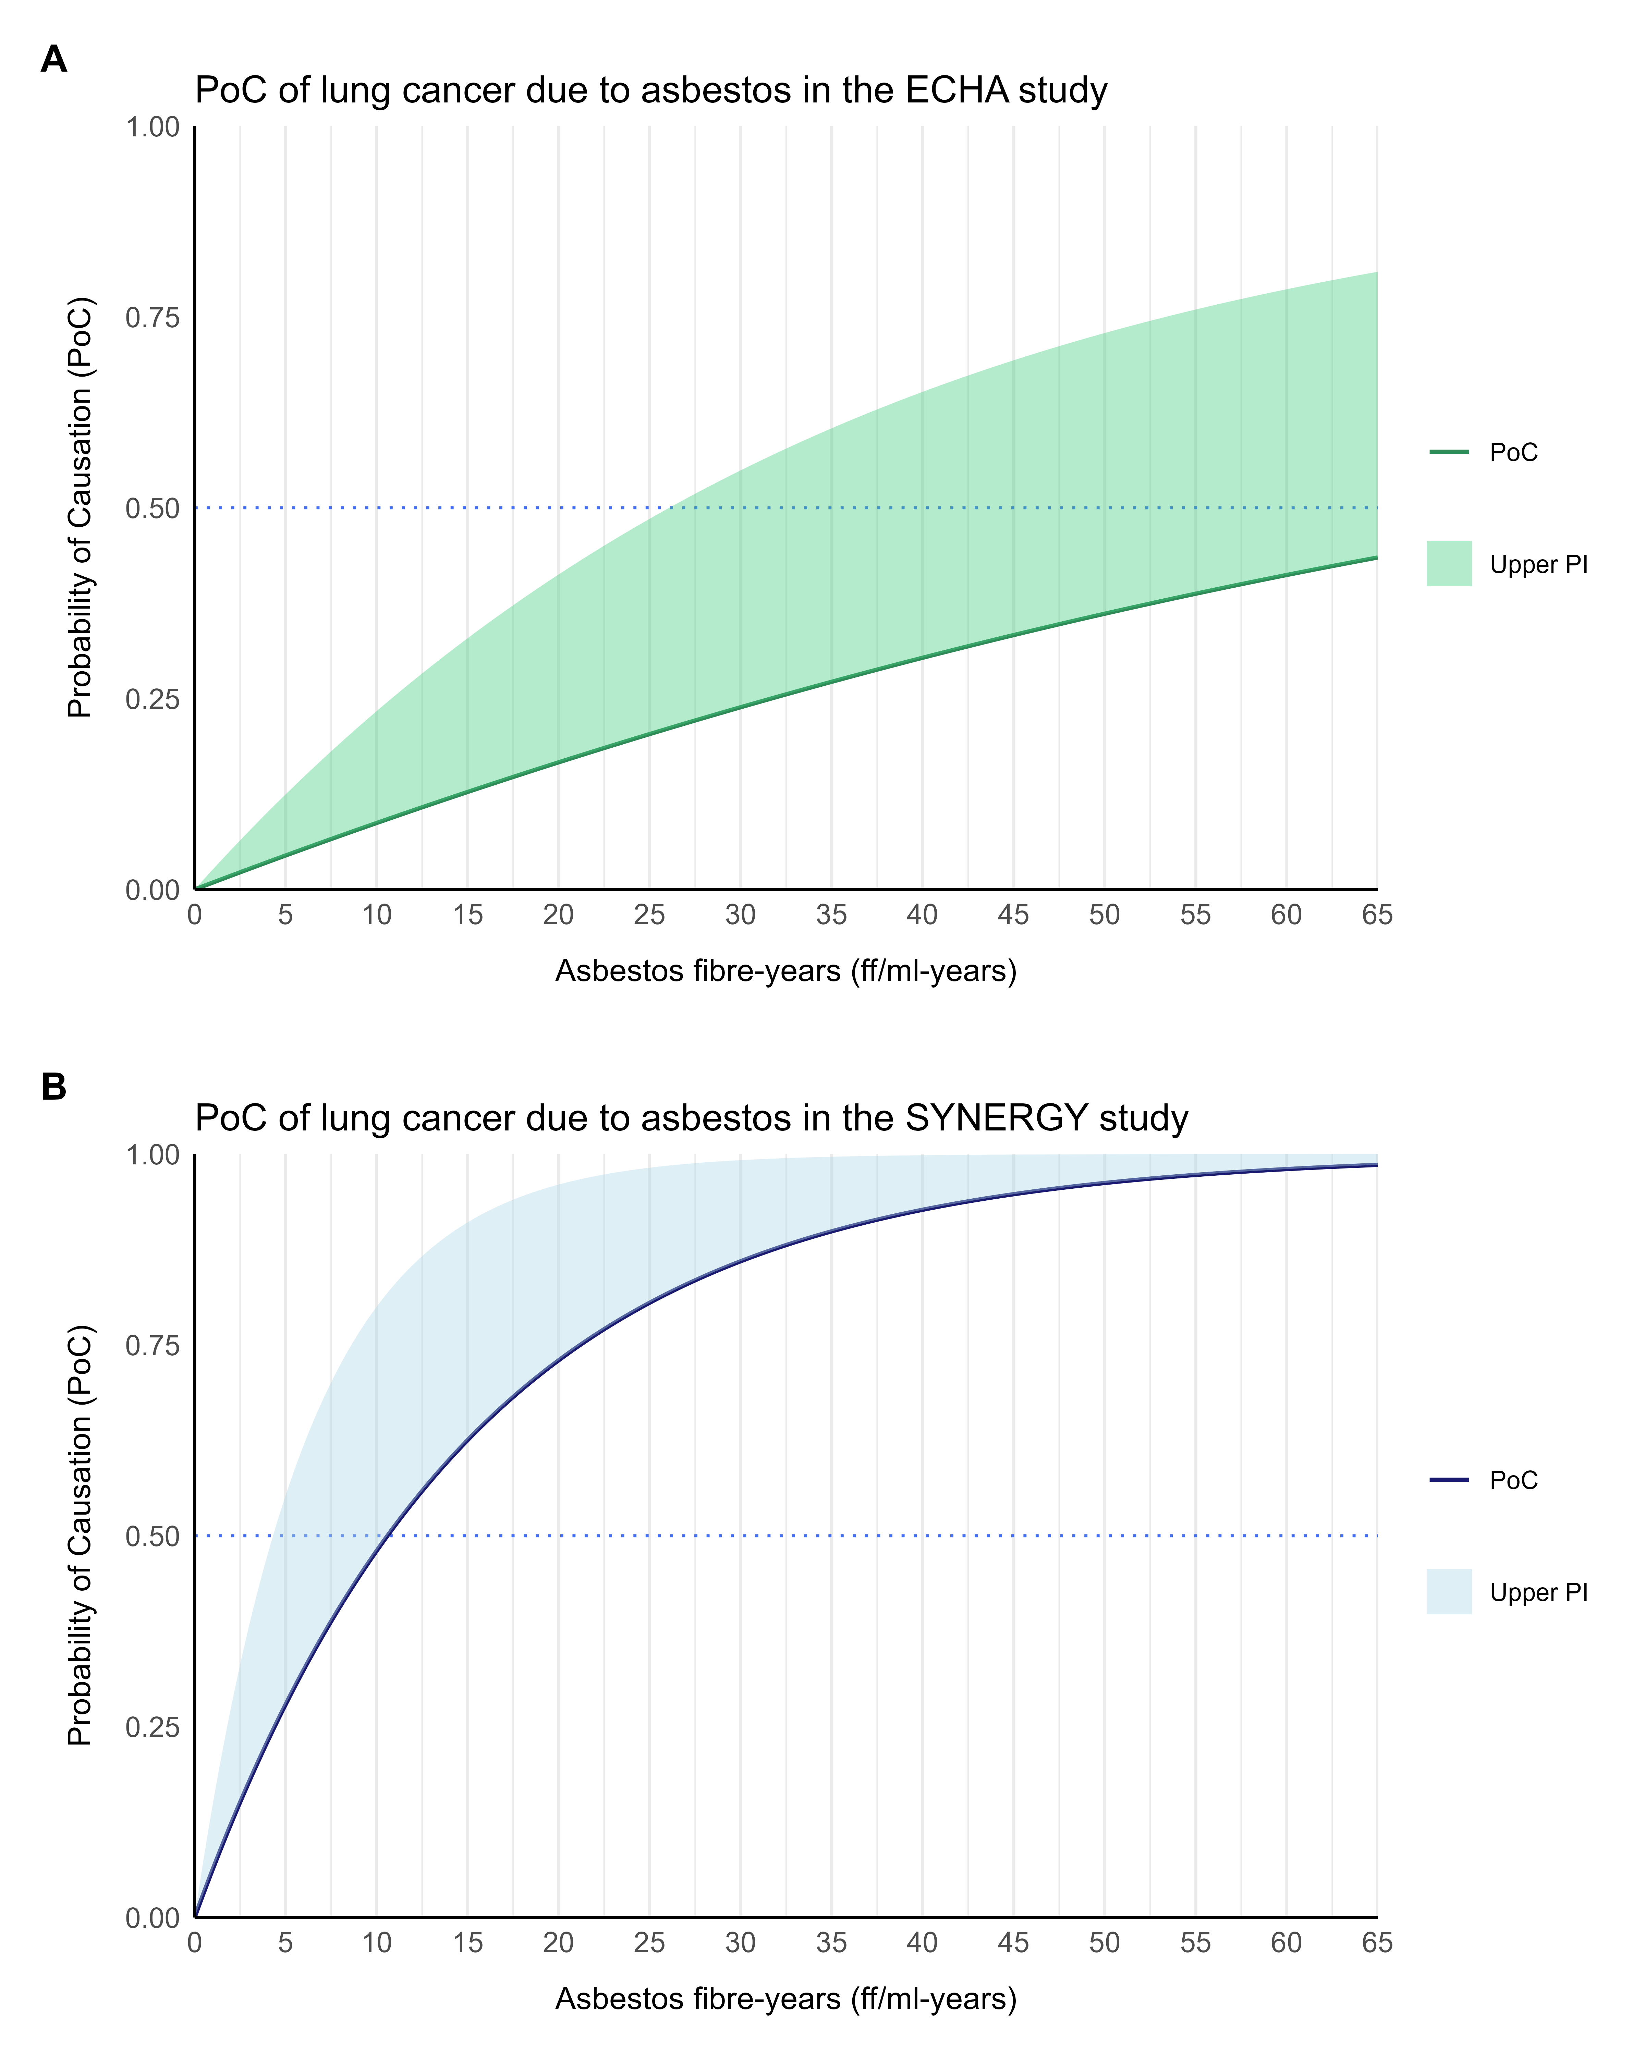
 | Min Exposure for 50% PoC
 | Point Estimate ff/ml-y | Upper 95% PI ff/ml-y
ECHA | 62.9 | 18.2
SYNERGY | 10.5 | 4.3
Helsinki (2014) | 25

Slide 19
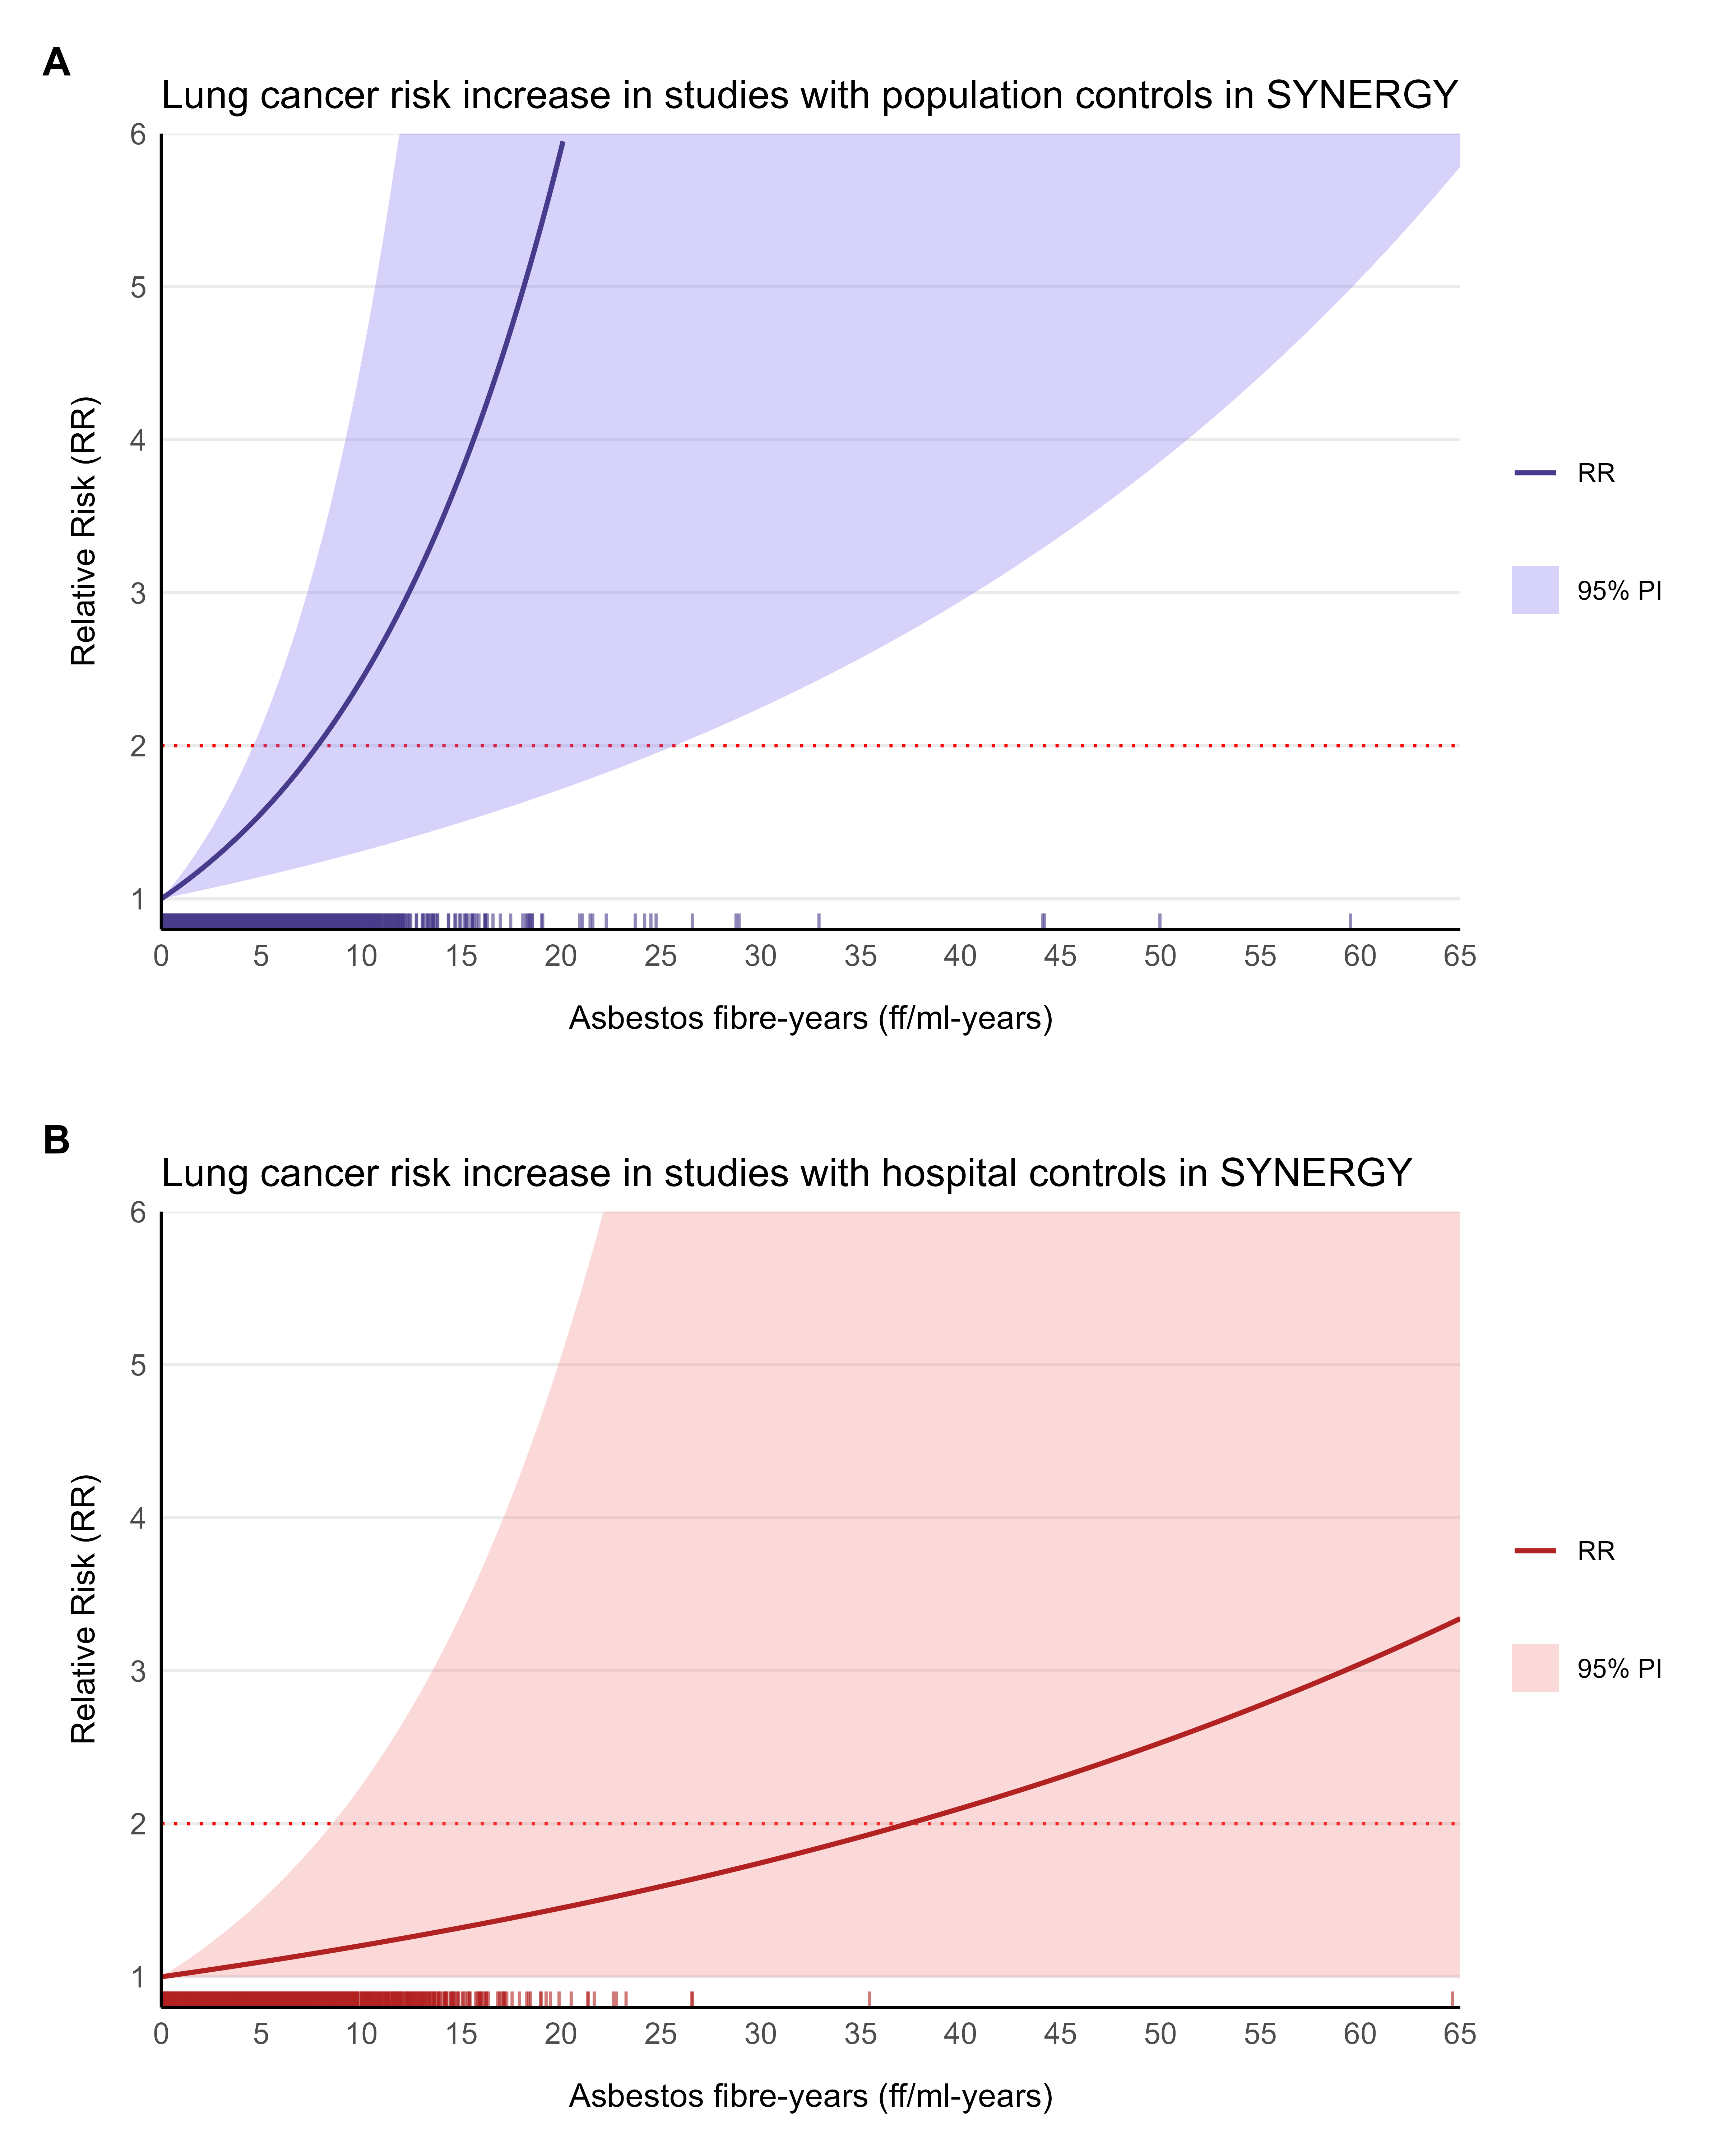
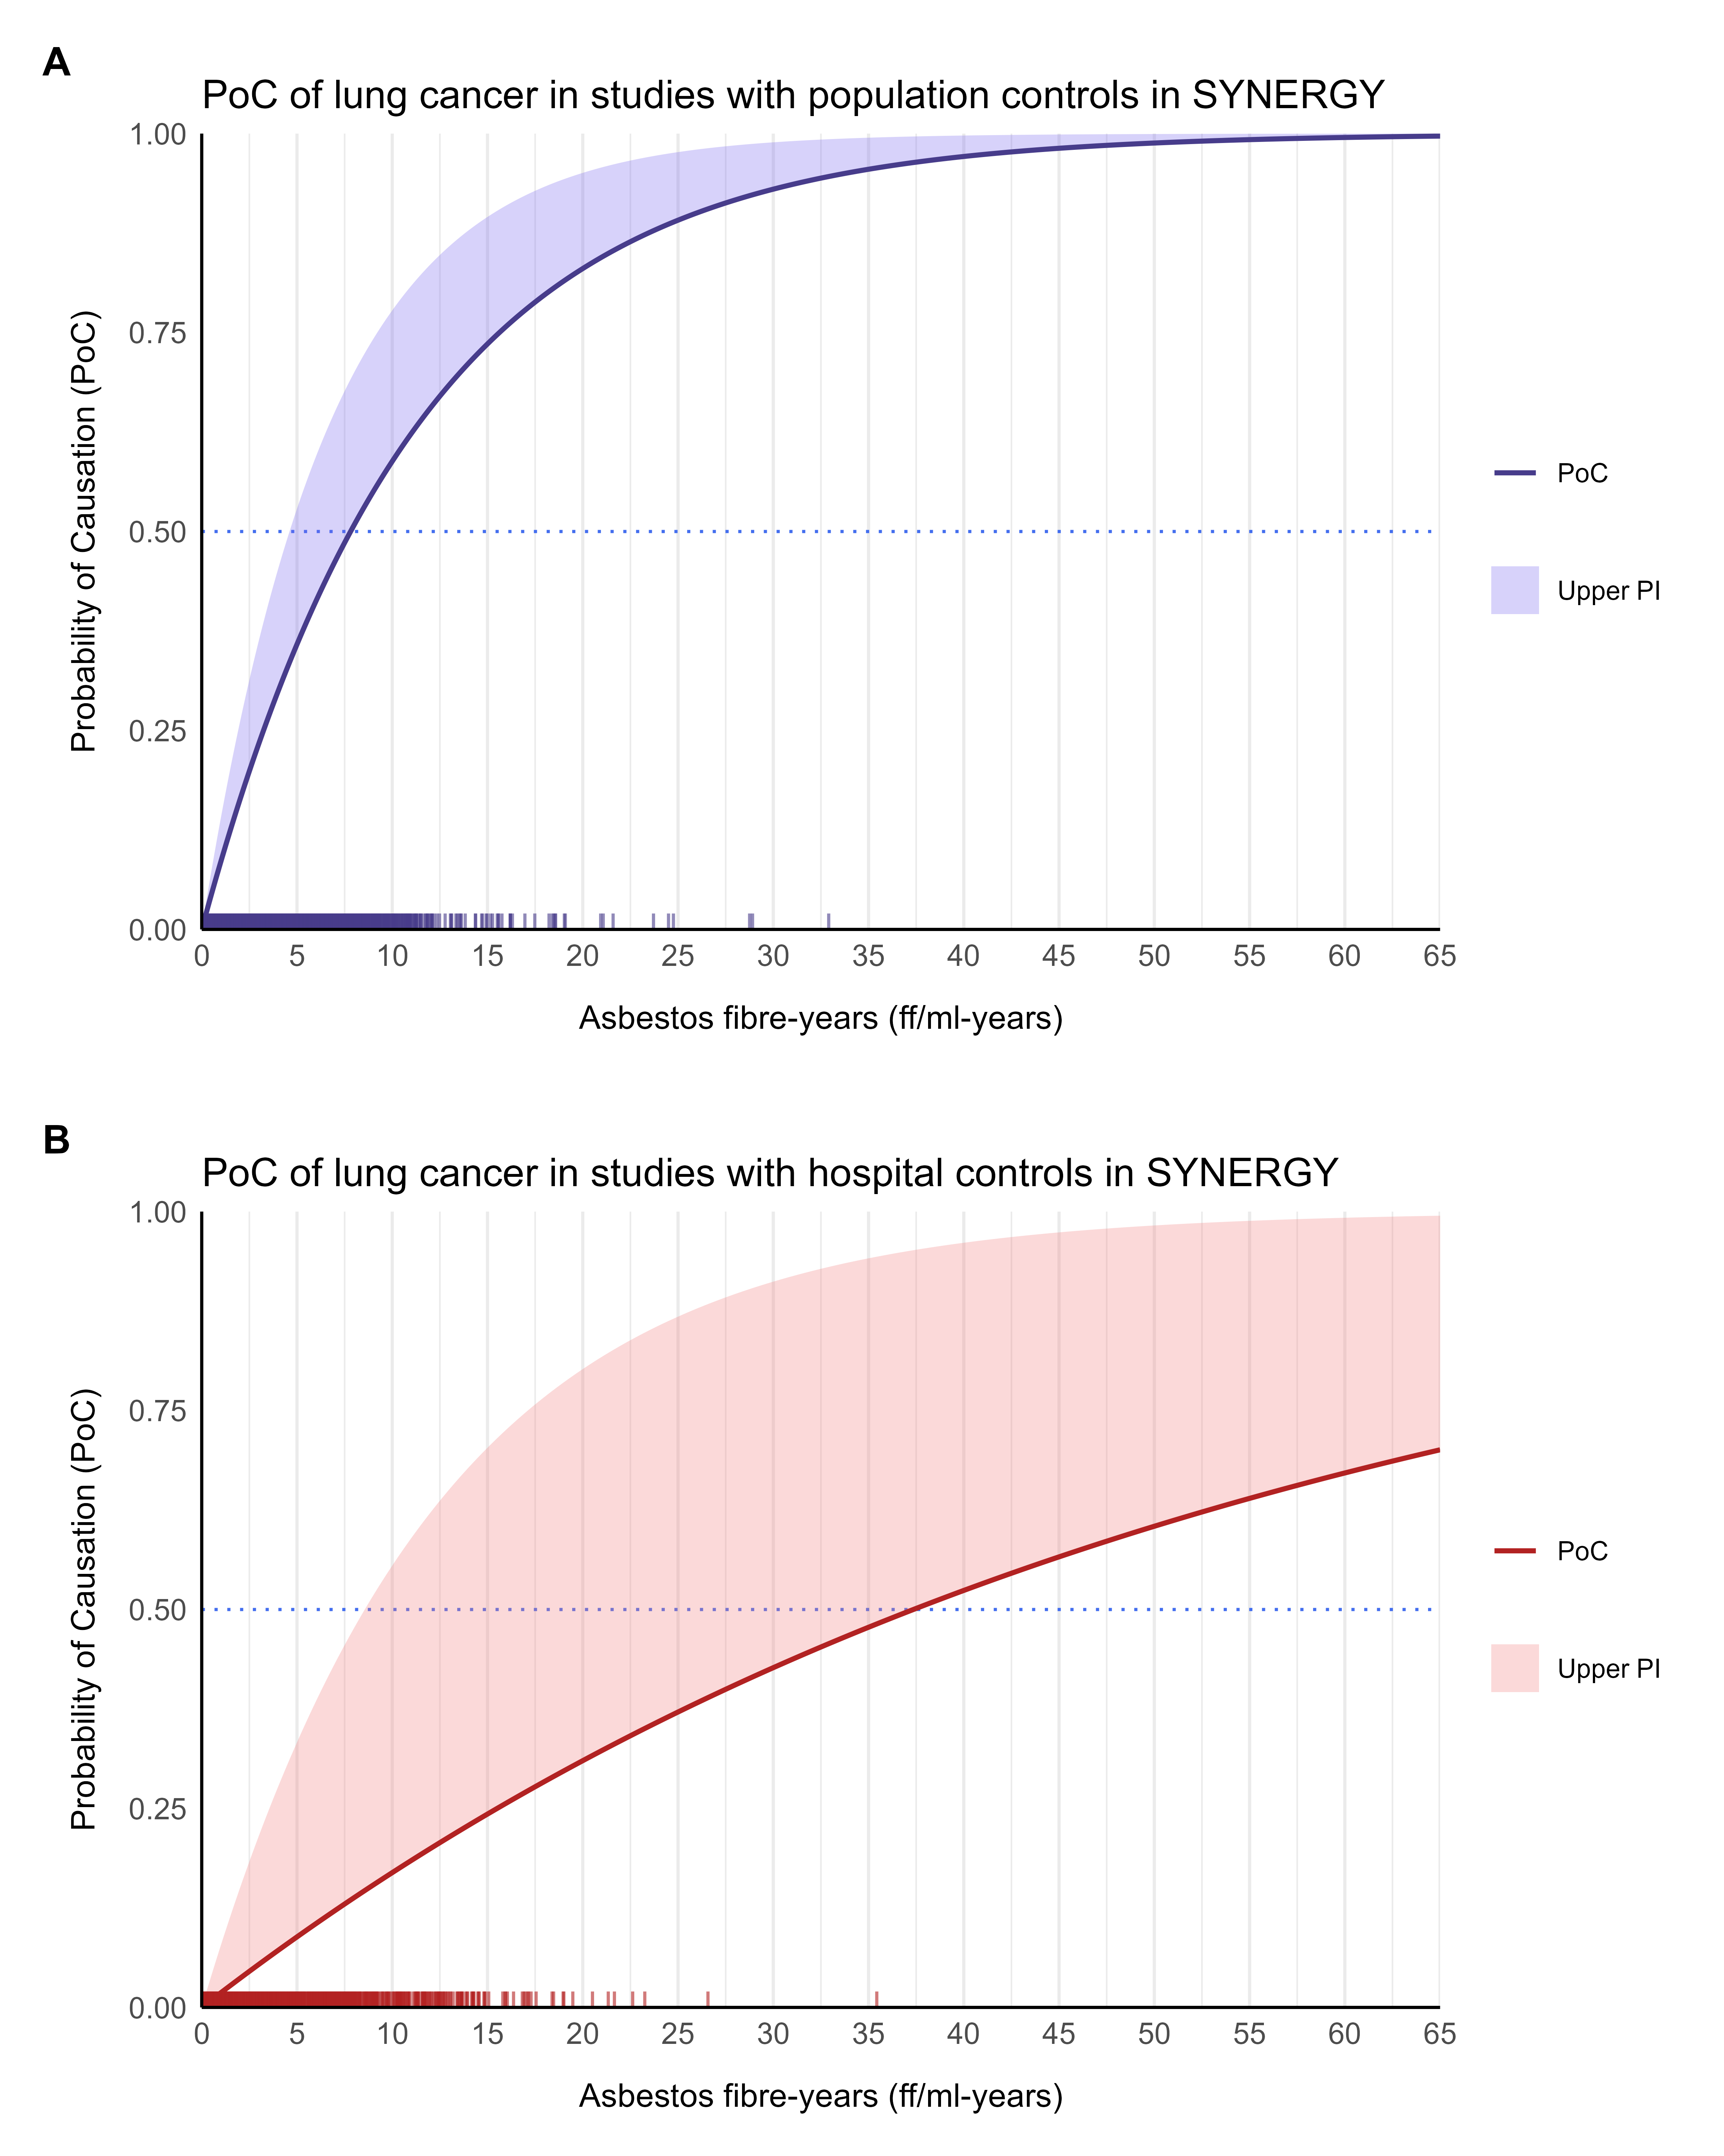

Slide 20
Discussion
Asbestos was banned in the Netherlands in 1993. Up to 17,500 lung cancer cases expected between 2011 and 2030. Asbestos still used in various LMIC.
SYNERGY estimates support lower compensation thresholds (4.3 fibre-years) than traditional Helsinki criteria.
ECHA exposure-response relation underestimated at lower currently relevant exposures.

Slide 21
Limitations of the PoC
Strong causal assumptions
What if cancer was accelerated by exposure?
Relies on population-average effects
Cannot differentiate between material and immaterial damages

Slide 22
Discussion: material and immaterial damage
Damage
Material: LOLE
Working life lost
Pension years lost
Immaterial: QAYLL
Suffering, pain, loss of enjoyment
Explicitly stating what part of the compensation covers for material and immaterial losses could be an improvement.

Slide 23
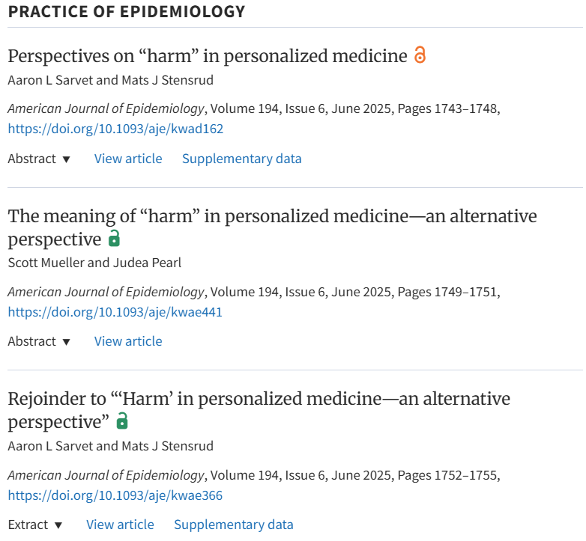
https://academic.oup.com/aje/issue/194/6

Slide 24
Back to our case… we can also think of PoC in terms of absolute risks. For that, we can first apply the inverse formula to obtain the RR.
RCS
Asbestos
Lifetime smoker
1.9 mg/m³-years
1.8 fiber-years
PoC = 0.55
RR = 2.2
PoC = 0.30
RR = 1.43
PoC = 0.25
RR = 1.33
Assume 64-year-old male with baseline cumulative risk of 1.6%:
+1.95 %
+0.7 %
+0.53 %
Smoking
RCS
Asbestos

Slide 25
RCS and asbestos did not actually double the absolute risk of lung cancer (+ 1.23% vs initial 1.6%). However, for the exposures assessed in SYNERGY, RR can be summed instead of multiplying (Olsson, 2024).
$$Risk = 1.6\% × \left(2.76\right)= 4.4\%$$
+ 2.8%
Olsson A. EHP. 2024;132(1):017005. doi: 10.1289/EHP13380

